Slide 1
Project / team overview
Knowledge Base
Formal specification
Mission command
Mission specification
Capability reasoning
Teaming plan
Can I participate?
Should I participate?
Verification
Verification
(Selva): How can a representation of knowledge be implemented such that answers to all relevant questions can be extracted?
(Kress-Gazit): How should we formalize a mission specification such that it can be used to generate teaming decisions that can then be subsequently verified?
(Sun): How can we efficiently compute whether a given agent is capable of participating in an incoming mission as specified?
(Mehta): If an agent is capable of participating, what is the algorithm that computes the mission objective from agent hardware, and what is the resulting utility?

Slide 2
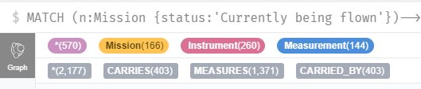

Knowledge representation (Selva)
Conducted literature review on
Knowledge representations (knowledge graphs, first-order logic, ontologies, rules, frames, Markov logics)
Methods to auto-generate or complete knowledge graphs (NLP, KG embeddings, Markov logic)
Identified tools to work with knowledge graphs (Neo4j) and Markov Logic (pracmln)
Defined an Earth Observation test case
Mission is to measure a certain parameter over a certain region, time frame with a certain set of attributes (spatial resolution, revisit time, accuracy) - pulled from WMO OSCAR database
Agents are any current Earth observation satellites – pulled from CEOS database
Identified tools to implement a demo (TurtleKit, Orekit, Cesium, VASSAR)
Started prototype implementation
Wrote web scraper for CEOS database
Imported CEOS DB into Neo4j as a KG
Wrote code to parse a KG into the corresponding MLN program
Continued definition of interfaces with tools from other team members.
Next steps:
Continue development of the prototype
Continue integration with other team members

Slide 3
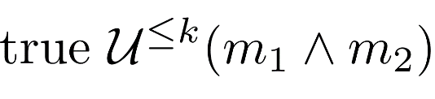
Mission Specification and Verification (Kress-Gazit)
Goal: Determine if the mission can be satisfied given the agents that have chosen to participate
To do so, we use Probabilistic Computation Tree Logic (PCTL) to write our mission specification
The system is modeled using a Markov Decision Process (MDP), which contains information about the states (which sensors are being used and which observables are being measured), and actions (switching between sensors)
We use the information from KG/MLN to automatically construct the MDP
Verify mission with respect to changing MDP probabilities that model system health
Next steps:
Automatically integrate specifications that model constraints on the agents
Add feedback loop in the event verification fails
Look into using SAT/SMT solver for one-time verification
Example mission: “m₁ and m₂ are measured at the same time within k time steps”

Slide 4
Knowledge Base Reasoning (Sun)
Conducted literature survey on
Knowledge graph inference: Knowledge graph embedding, logical rule-based knowledge graph inference (e.g., Markov Logic Network), integrating knowledge graph embedding and logical rules
Uncertainty in knowledge graph: probabilistic soft logic, hinge-loss Markov Random Field
Examined existing approaches on combining knowledge graph embedding and logical rules
Category I: treat logical rule as regularization, e.g., KALE, RUGE
Category II: use embedding/graph neural networks to define variational distribution to boost Markov Logic Network, e.g., pLogicNet, ExpressGNN
Proposed an efficient algorithm to combine the two worlds, UniKER
Solution: (1) use forward chaining to infer unseen triples; (2) use updated facts to conduct knowledge graph embedding; (3) repeat (1) and (2) to handle noise triples
Results: achieve the state-of-the-art of performance in terms of both effectiveness and efficiency
Next steps
Handle uncertainty of knowledge graphs: for both observed facts and logical rules
Handle attribute triples, e.g., (Mid_Infrared_Sensor, battery_life, value)
Examine possible constraints by formalizing them into logical rules
Integrating sensor network output (e.g., via Kalman filtering-based signal processing) to knowledge graph inference

Slide 5
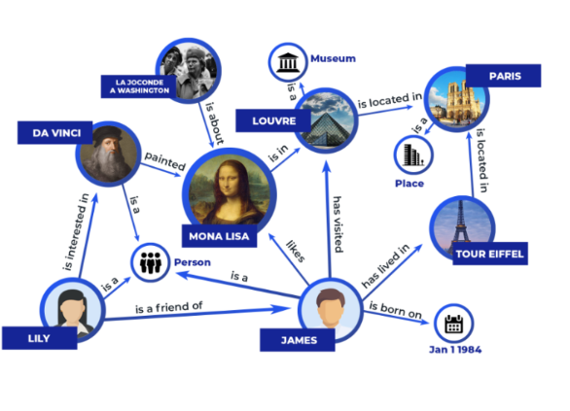
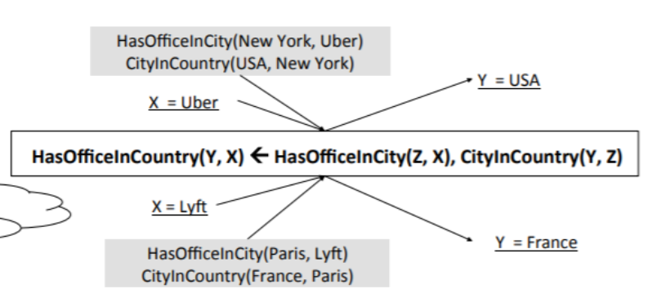

Illustration of UniKER
Knowledge Graph Embedding
Logical Rule-based Reasoning
Denoise Knowledge Graph by removing noisy facts
Logical
Rules
Knowledge
Graph
Forward Chaining
…
…
…
HasOfficeInCountry(USA, Uber)
HasOfficeInCountry(France, Lyft)
Embeddings
…
Enhance Embedding by including new facts
New Facts
…
…

Slide 6
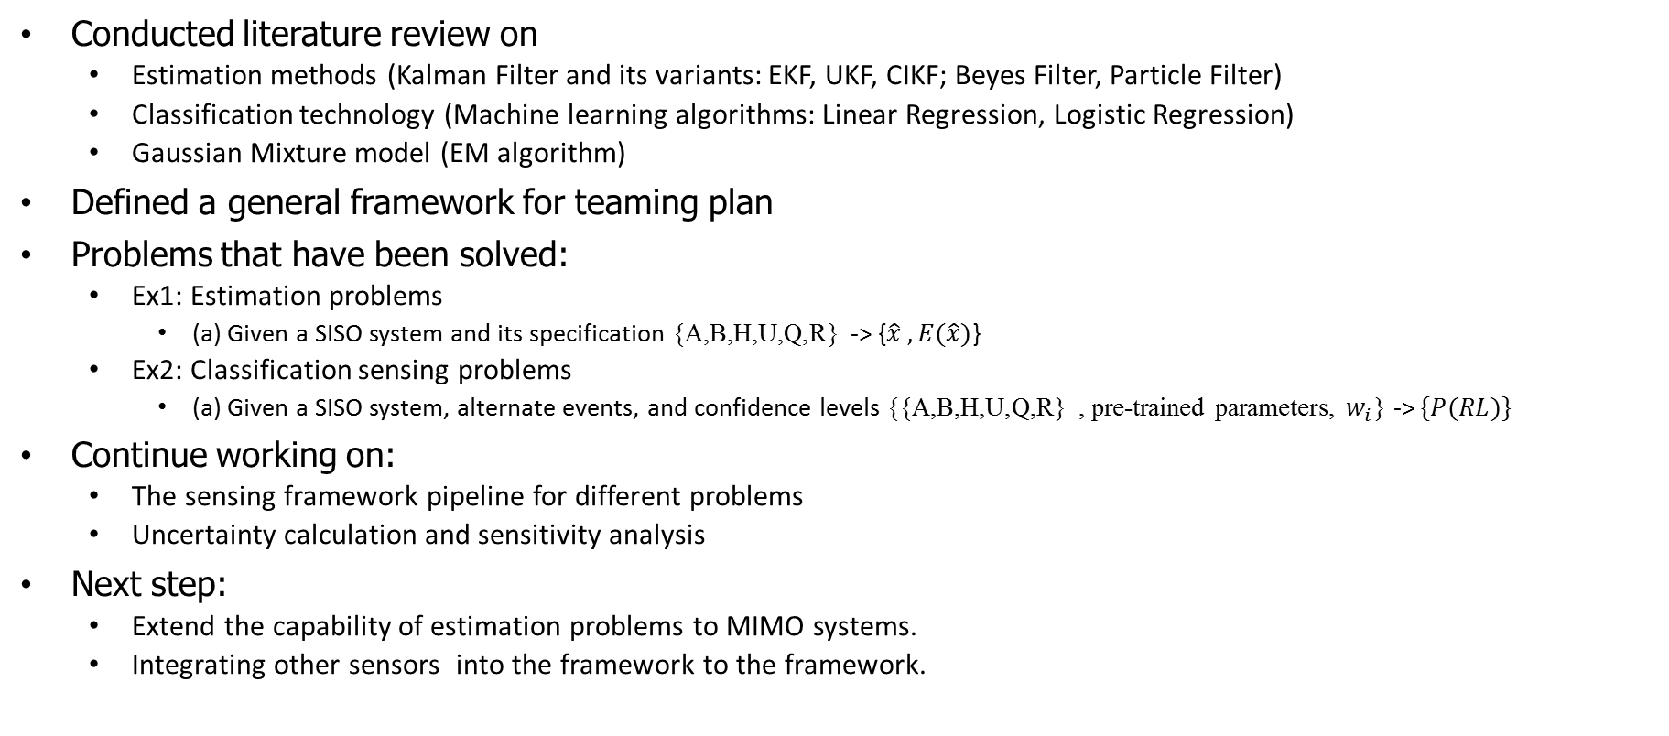
Sensing Framework (Mehta)
Conducted literature review on
Estimation methods (Kalman Filter and its variants: EKF, UKF, CIKF; Beyes Filter, Particle Filter)
Classification technology (Machine learning algorithms: Linear Regression, Logistic Regression)
Gaussian Mixture model (EM algorithm)
Defined a general framework for teaming plan
Problems that have been solved:
Ex1: Estimation problems
(a) Given a SISO system and its specification {A,B,H,U,Q,R} -> {$\hat{x} , E(\hat{x})$}
Ex2: Classification sensing problems
(a) Given a SISO system, alternate events, and confidence levels {{A,B,H,U,Q,R} , pre-trained parameters, $w_{i}$} -> $\{P(RL)\}$
Continue working on:
The sensing framework pipeline for different problems
Uncertainty calculation and sensitivity analysis
Next step:
Extend the capability of estimation problems to MIMO systems.
Integrating other sensors into the framework to the framework.

Slide 7
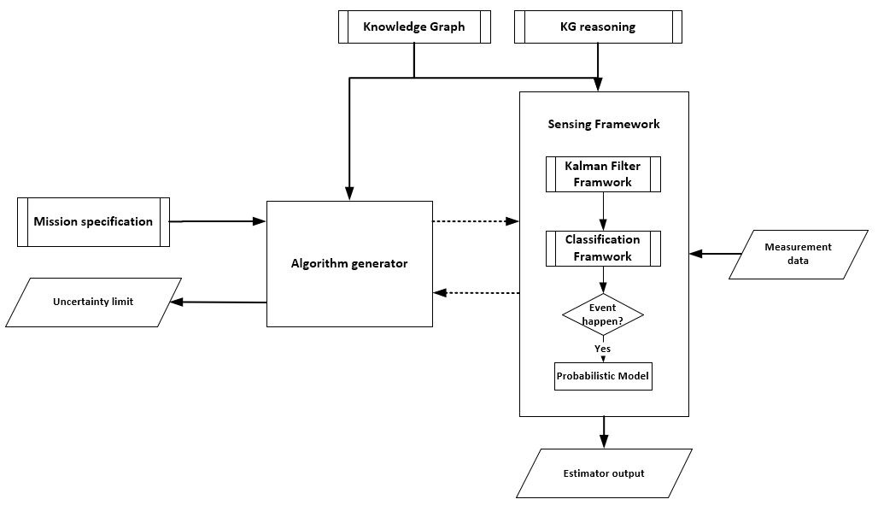
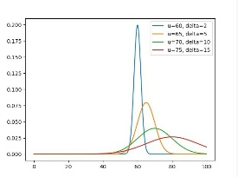
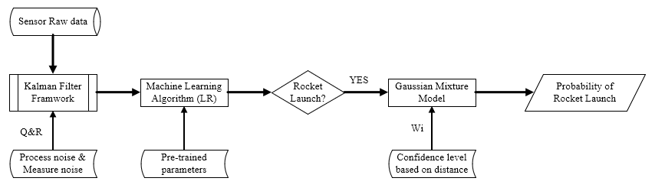
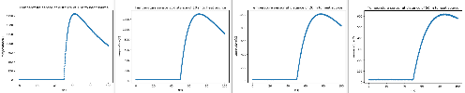
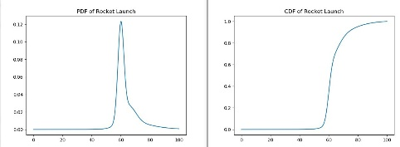

Illustration of sensing data flow
General teaming framework
Example sensing pipeline

